Slide 1
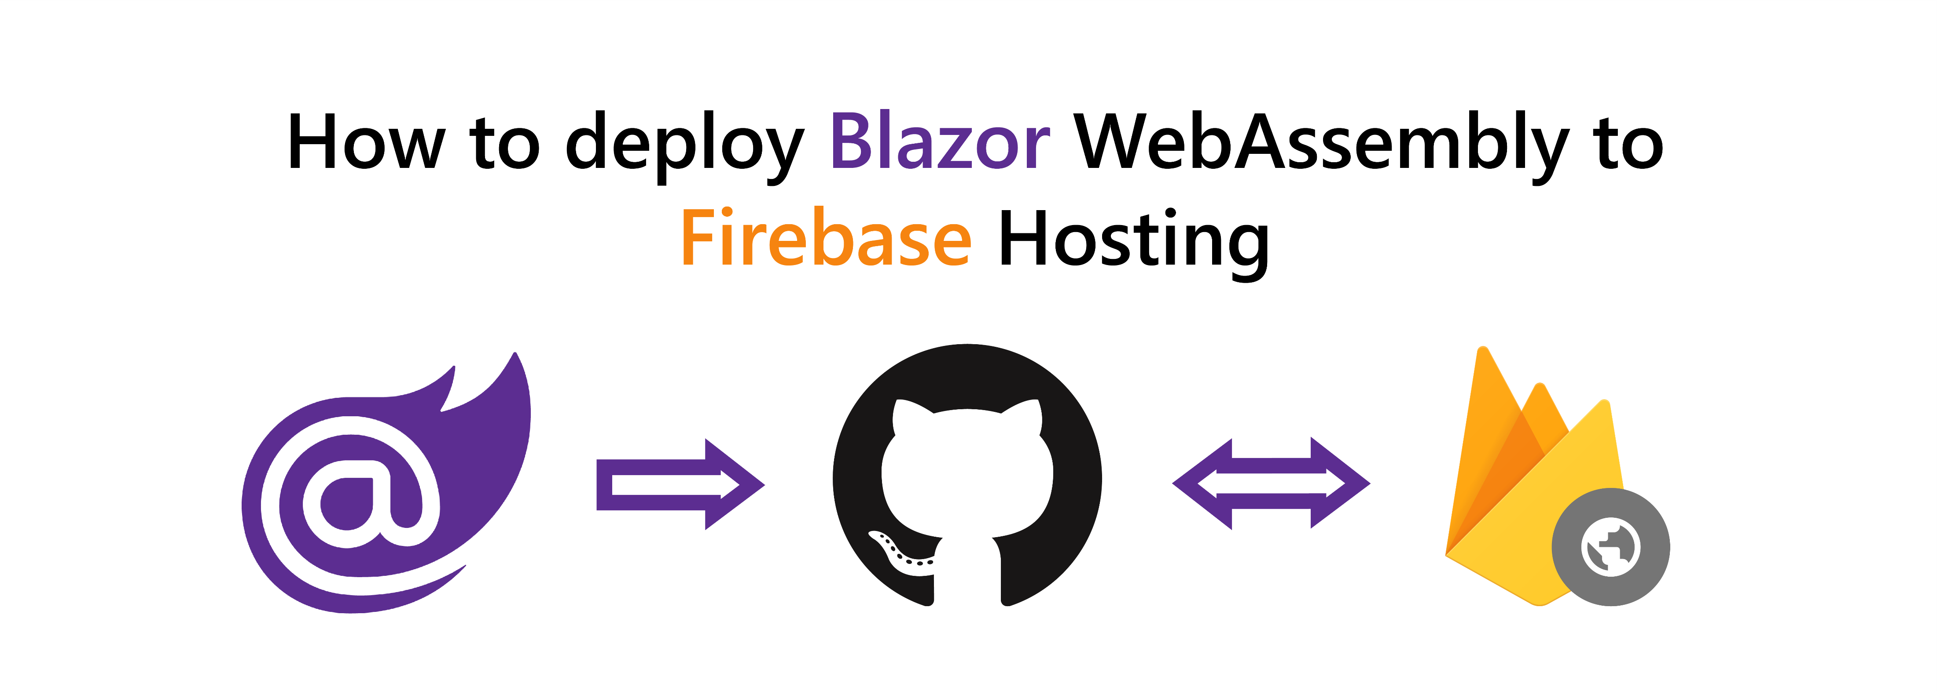

© Niels Swimberghe
https://swimburger.net - @RealSwimburger
Notes:
Hello, what’s up everybody. My name is Swimburger. And Today we are going to learn how to deploy Blazor WebAssembly to Firebase Hosting.

Slide 2

About me
Niels Swimberghe aka Swimburger
.NET Web Developer
Blog at swimbuger.net
Twitter: @RealSwimburger

Slide 3

What is Firebase Hosting?
Static site hosting service (HTML, CSS, JavaScript, etc.)
Support custom domains
Part of Firebase suite of products and services
Free Spark plan:
10GB storage
Max 360 MB/day data transfer 😿
Blaze plan:
10GB free + $0.026/GB for storage
360 MB/day + $0.15/GB data transfer
For perspective, swimburger.net served 956 MB to serve 691 unique users Today (1/17/2021 according to Cloudflare stats)
Notes:
But first, what is Firebase Hosting? Firebase Hosting is a static site hosting service and is part of the suite of products and services offered by Google Firebase.
It supports custom domains, but the free plan is very limiting. The maximum data transfer per day is only 360megabytes.
After the free 360megabytes per day, you can pay 15cents per additional gigabyte. For perspective, according to Cloudflare’s statistics, Swimburger.net almost served a gigabyte of data to serve about 6 to 7 hundred users Today.

Slide 4

Alternatives?
Azure Static Web Apps (Blazor WASM Walkthrough)
GitHub Pages (Blazor WASM Walkthrough)
Netlify
Vercel
Cloudflare in front of Firebase Hosting
Many more
Notes:
If Firebase doesn’t work out for you for some reason, there are many alternatives such as Azure Static Web Apps, GitHub Pages, Netlify, and many more.
You can also put a reverse proxy service like Cloudflare in front of Firebase Hosting to lower the cost.

Slide 5
What are we going to do?
Create a Blazor WASM project
Create a GitHub repository (optional)
Deploy to Firebase Hosting from the CLI
Automatically deploy to Firebase Hosting using GitHub Actions (optional)
Notes:
So we are going to do the following steps in this tutorial. First we’ll create a Blazor WASM project,
Then we’ll create a GitHub repository and push the code to GitHub
Then we are going to use the Firebase CLI to deploy our web application to Firebase Hosting
Lastly, we’ll automatically deploy the application using GitHub Actions

Slide 6

SUCCESS!?

Slide 7


More .NET, Web, Azure, etc.
@RealSwimburger
https://swimburger.net

